Slide 1
Project Sprint 1
Rating National Parks

Slide 2
Goals for this sprint
Get a shared Database for us to collaborate together on
Collect data and create .csv files for the remaining Entity sets
Write sql queries to represent relationships between entity sets
Consult TA for further development for this sprint and further sprints
Making our primary keys and FDs for each table as well and confining are tables are normalized.
Notes:
The goals which we had for this sprint were setup a shared database for us to collaborate on, collect our data for our tables representing our ERD, write some example sql queries for the relations in the database, consult the TA for advice and start normalizing our data.

Slide 3
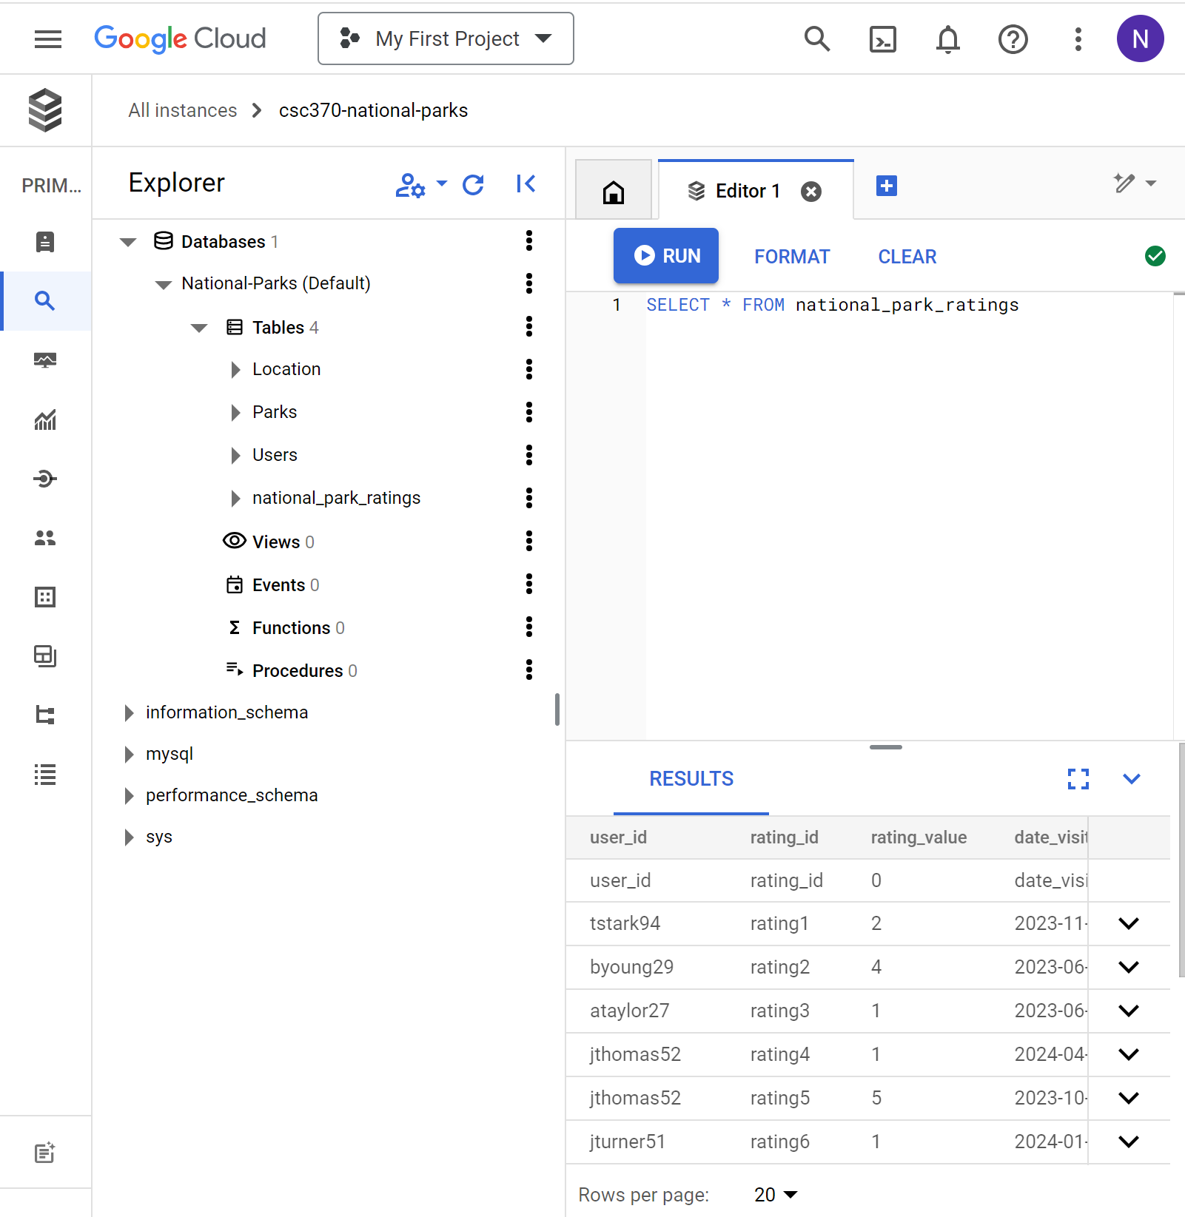
Set up shared database
We utilized Google cloud to set up a collaborative shared database
Had difficulty loading the .csv files when trying to create tables in the database
Google Cloud had slightly different syntax for MySQL shown in lecture
CSV imports to database were unmodifiable in format which added difficulties
All datatables were successfully entered
Notes:
To setup the shared database we initially tried using amazon aws but after facing some difficulties we consulted the TA for their advice on setting up a shared database and they recommended we switch from amazon aws to google cloud which we did, and made our lives easier.
As shown on the right, this is the google cloud database.

Slide 4
Data Collection and Table Creation
Created the following .csv file tables in addition to the Parks table
Users
Utilized Chat GPT to populate the table with User_Id, Name, Email and Password
Parks
Wiki list for park names and chatgpt was used to gather coordinates
Location
Utilized Chat GPT to get the Addresses from the park name
Weather Stations
Utilized Chat GPT to create distinct 10-digit IDs for every weather station. Each station is associated with fabricated yearly average weather information and coordinates indicating the nearest park. Please note that both the weather data and stations are fictional.
Ratings
Python script to generate random user ratings from user id’s

Slide 5
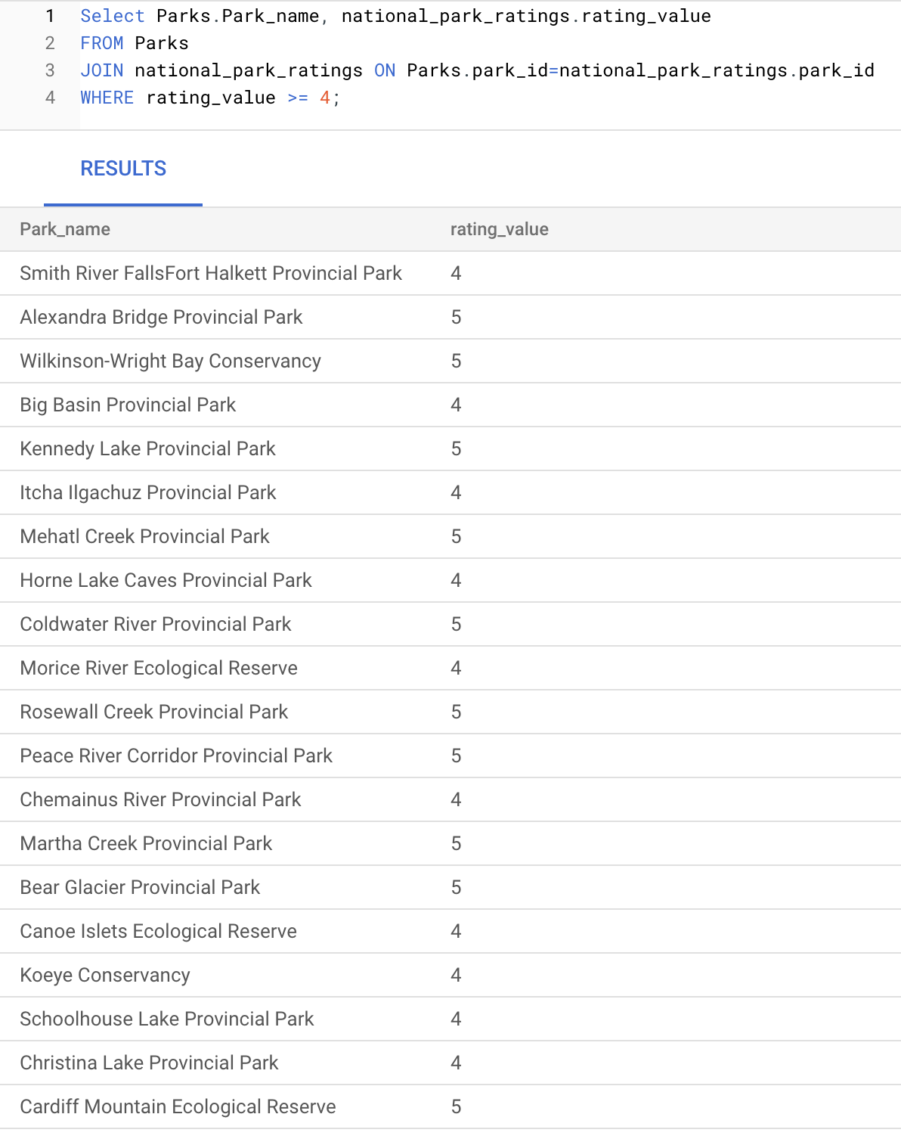
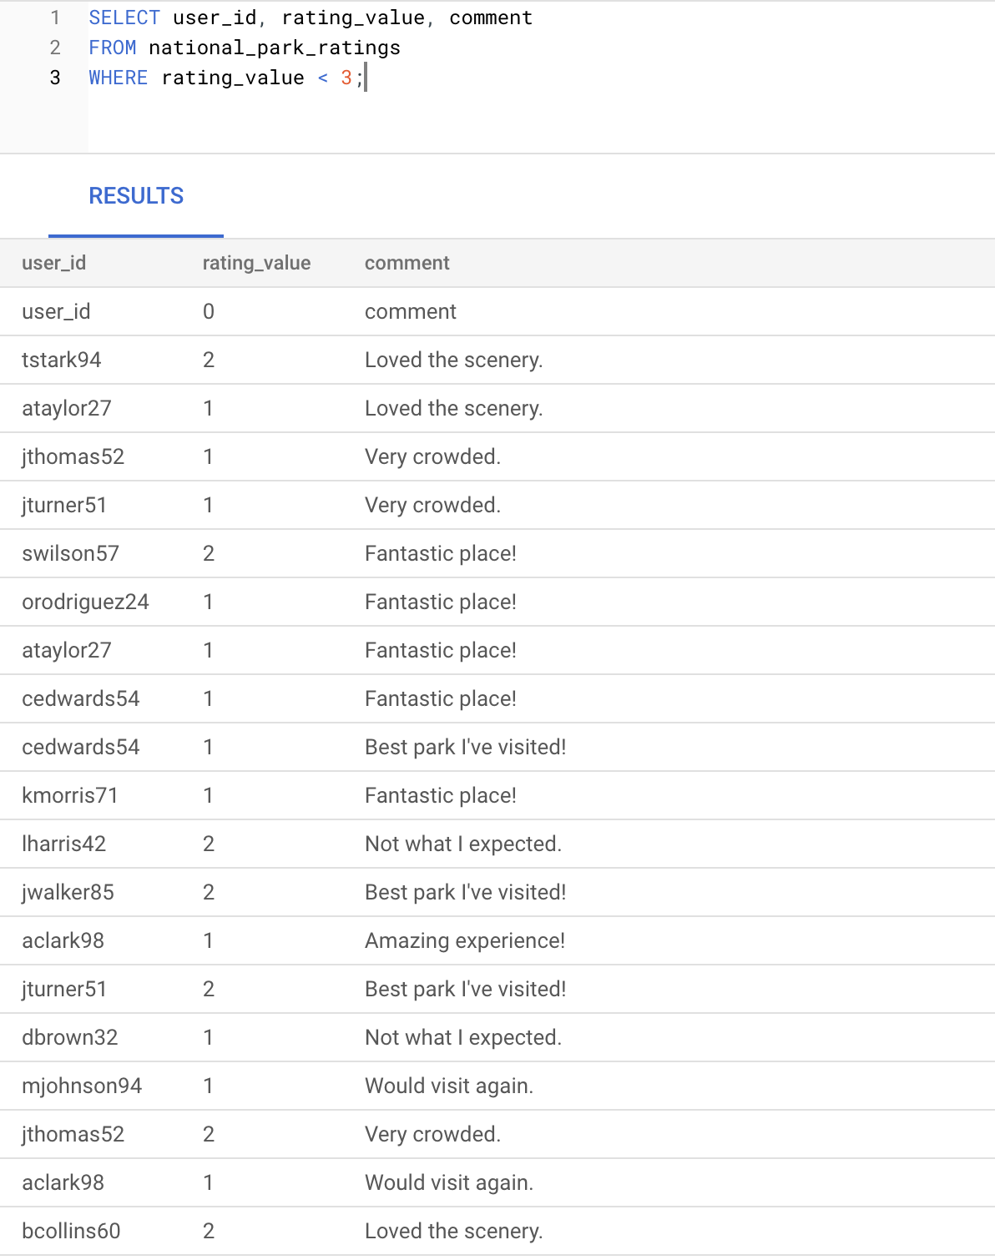
Sample SQL Queries

Slide 6
Primary keys and FDs for each table
Location:
Address is the primary key for the Location table
Address -> province/territory coordinates
Coordinates -> province/territory
Users:
User_id is the Primary Key for the User table
User_id -> Username Password Access_Level email
Email ->Username Password
Ratings:
rating_id is the primary key for the Ratings table
Rating_id -> all other attributes
Parks:
Parks_id is the primary key for the Parks table
Park_id -> all other attributes
Weather_station:
Station_id is the primary key for the Weather station table
Station_id -> all other attributes

Slide 7
Competencies for this sprint
Data analytics
Created Sql queries to demonstrate relationships between databases fulfilling lvl 1
Data architect
Created tables in database fulfills level 1.
Back-end engineer
This sprint had no back end engineering component outside planning for future back end engineering in future sprint

Slide 8
Goals For Next Sprint
Complex sql queries to demonstrate the relationships between databases
Success criteria: express all of our relationships between tables.
Demonstrate sql queries aggregating certain elements such as parks and locations in related databases.
Success criteria: write sql code which demonstrates the groupings we intend to use for the duration of the project. Some examples being Park rating, user ratings and park weather over time.
Fulfilling competency data architecture level 2 by normalizing all data sets and determining which attributes our data has such as NOT NULL and UNIQUE

